Slide 1
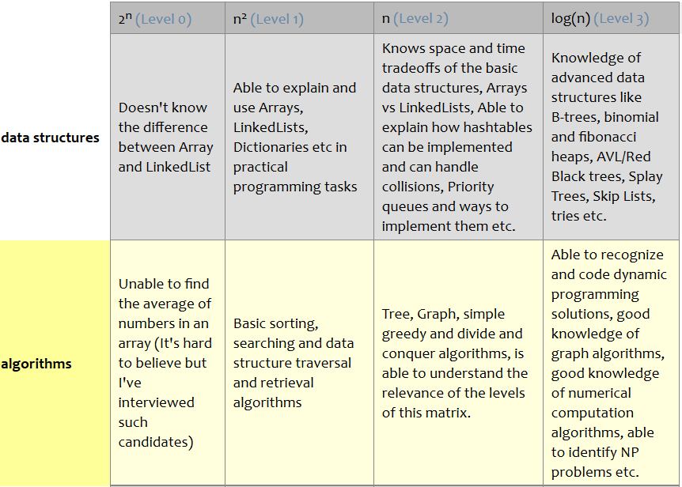
Welcome to CS202!
The world only cares about — and pays off on —
what you can do with
what you know (and it doesn’t care how you learned it)
Laszlo Bock, Senior VP, Google
Source: http://www.starling-software.com/employment/programmer-competency-matrix.html

Slide 2
Instructor Details and Course Overview
Course in Charge: Co-instructor:
Prof. Viraj Kumar Prof. Madhura V.
viraj.kumar@pes.edu madhura.v.madhu@gmail.com
Office: opp. Room B-301 Office: Staff Room (Ground Flr)
Course policies:
T1 and T2 are computer-based and worth 15% each
Comprehensive Final is written and worth 40%
One A4-sized handwritten cheat-sheet allowed on all exams
T3 policy
Project (groups of 2 or 3, no exceptions): Part 1 (5%) and Part 2 (20%)
Cheating Policy: Any attempt to pass off someone else’s work as your own, or to assist someone else (actively or passively) in such an effort, is considered cheating. The penalty for any such offence will be zero for all involved students.

Slide 3
Course Project: Two Options
Fast track: Complete project in Data Structures Made Easy (UCSD); coursera.org/learn/data-structures-optimizing-performance (Java)
NOT: coursera.org/learn/data-structures
Register by Aug 6, complete work by Sept 11, viva date TBA
Regular track: Complete in-course project (any language other than C)
Can combine this with other course projects (e.g., Web Tech.)
Common concept: Edit Distance between two words (operations allowed: insert, modify, delete one letter at a time)
e.g., time → stime → spime → spame → space (edit distance = 4)
A twist: intermediate words must be valid English words (vocab. game)
time → tame → fame → face → pace → space (edit distance = 5)

